Slide 1
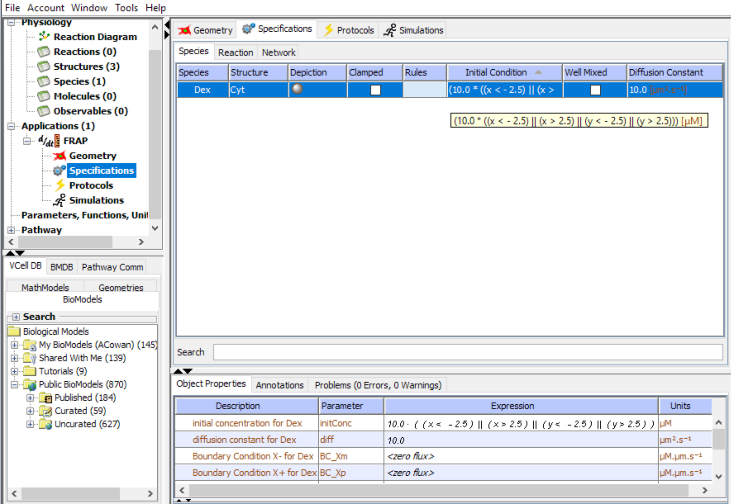
Select “Specifications” to define the initial distribution of dex. Type the Boolean expression shown either by replacing the text directly in the Initial Condition box, or type in the “Expression” box in the properties pane below.
Note: A Boolean expression evaluates as 1.0 when true and 0 when false. The expression defines the concentration of dex as 10 µM when x is less than -2.5 OR greater than 2.5, OR when y is less than -2.5 OR when y is greater than 2.5); otherwise, the value is 0.

Slide 2
Use the default value of 10.0 µm²/s for the Diffusion Constant for Dex

Slide 3
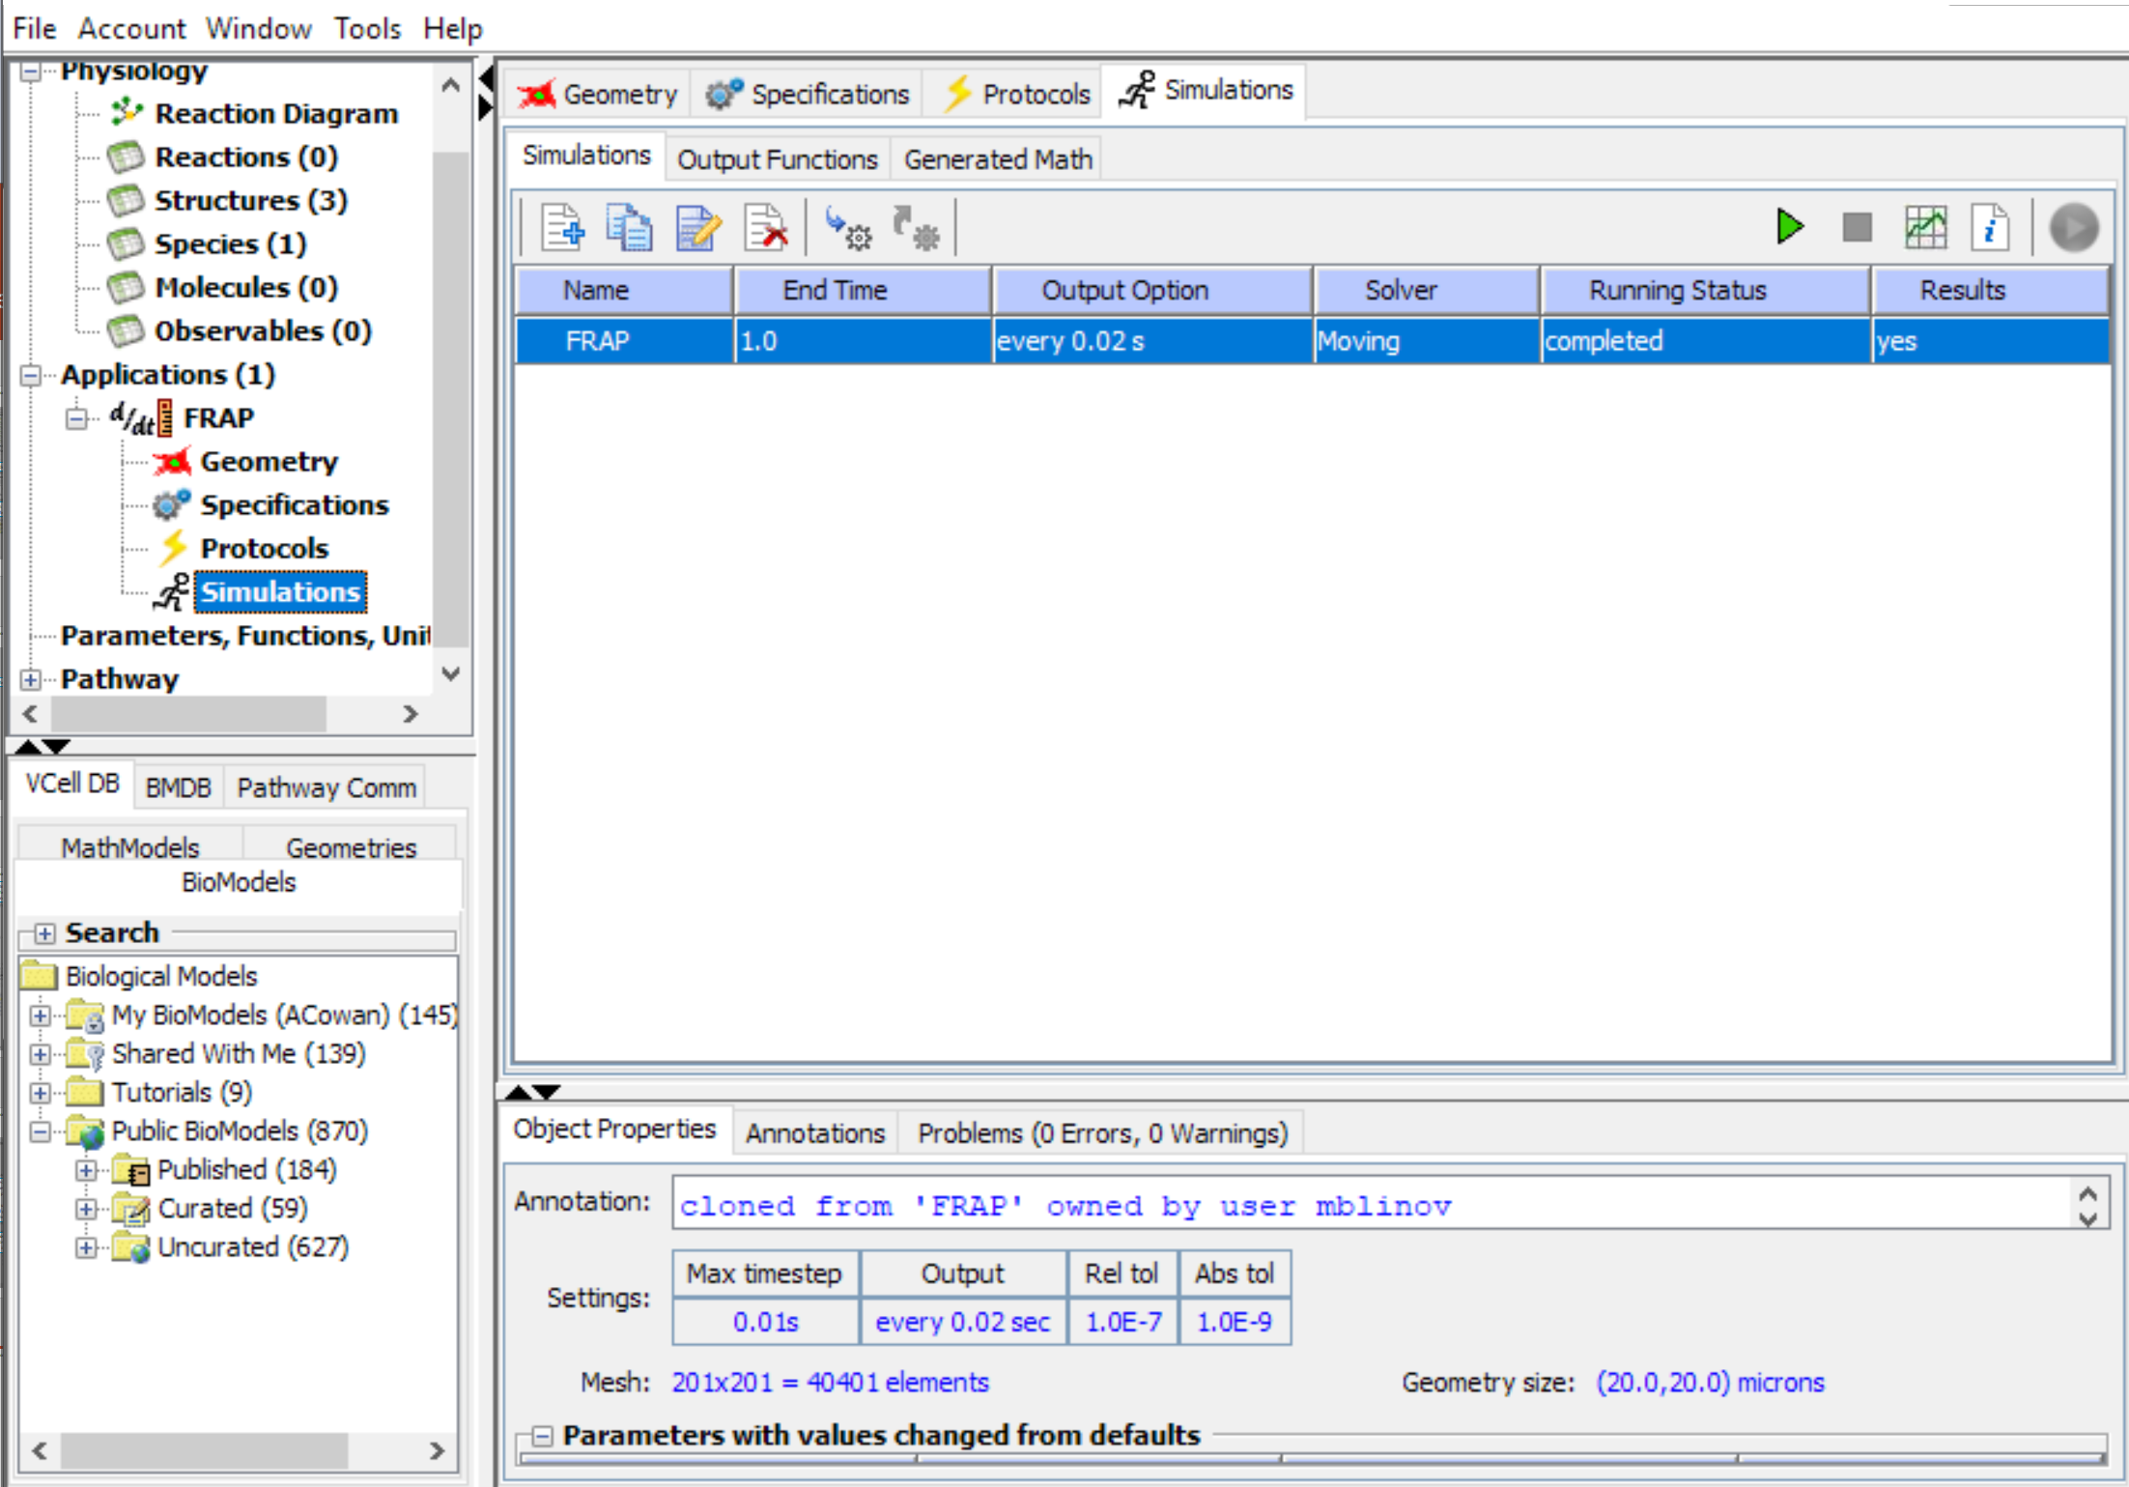
Go to the Simulations page.
Click on the “Simulations” tab and then the New Simulation icon to create a simulation.
To edit the simulation, click the Edit Simulation icon to access the Edit Simulation Dialog.
Note: You can create many different simulations from a single Application, varying the length of time, spatial resolution, parameter values, solvers, etc.

Slide 4
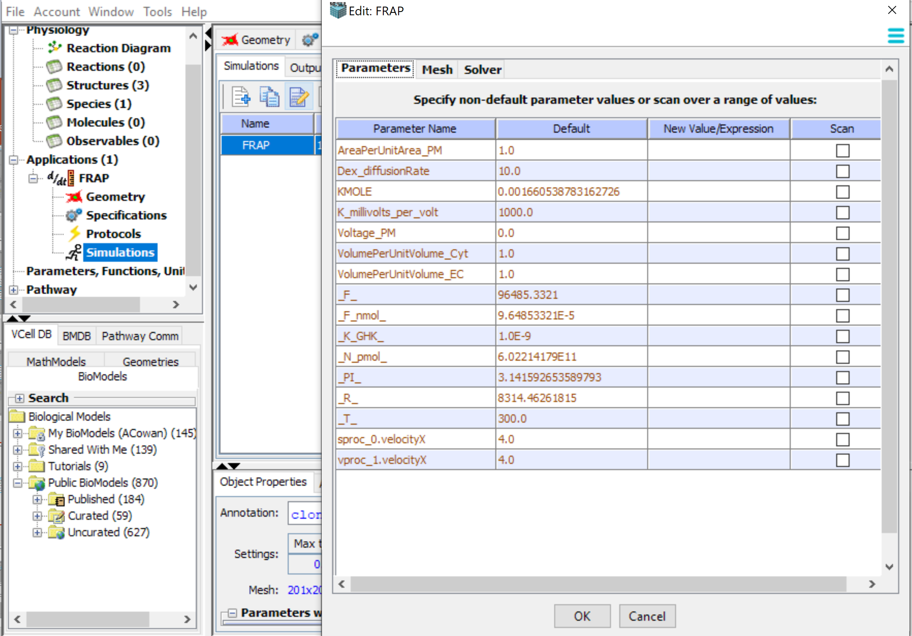
The Edit Simulation Dialog has 3 tabs. The Parameters Tab is used to adjust parameters for each simulation, or to scan multiple parameters. Use the Default settings for this tutorial
Click the “Parameters” tab to view or edit the parameters (e.g. rate constants or initial concentrations in the model). In this tutorial you can leave the parameters as initially described.

Slide 5
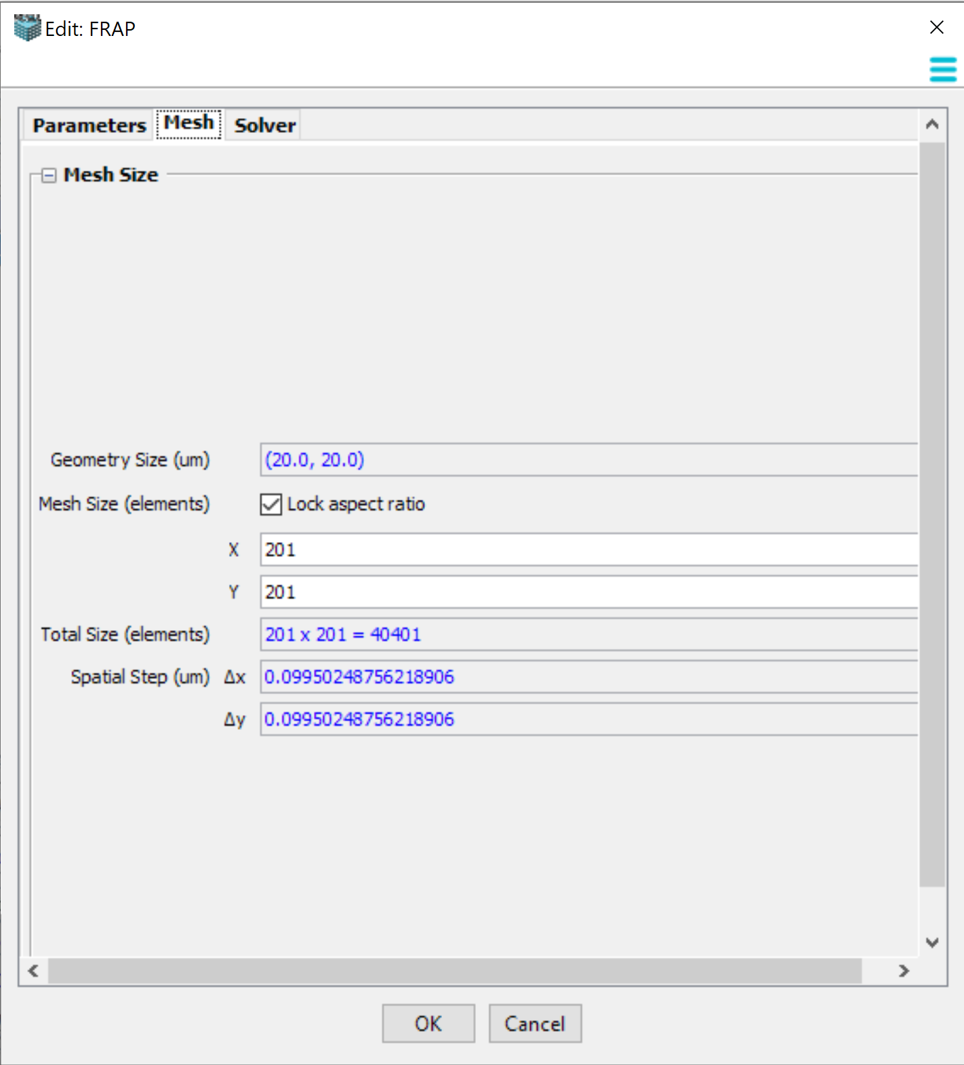
Select the “Mesh” tab to edit the mesh resolution for the simulation in the X and Y planes. Select “OK” to accept any changes.
Use “Lock aspect ratio” to keep the values proportional.
The larger the total size of the mesh elements the more accurate the solution, but the simulation will be slower.
Note: Use the smaller mesh size values shown here for the tutorial, or the simulation will take a long time to run.

Slide 6
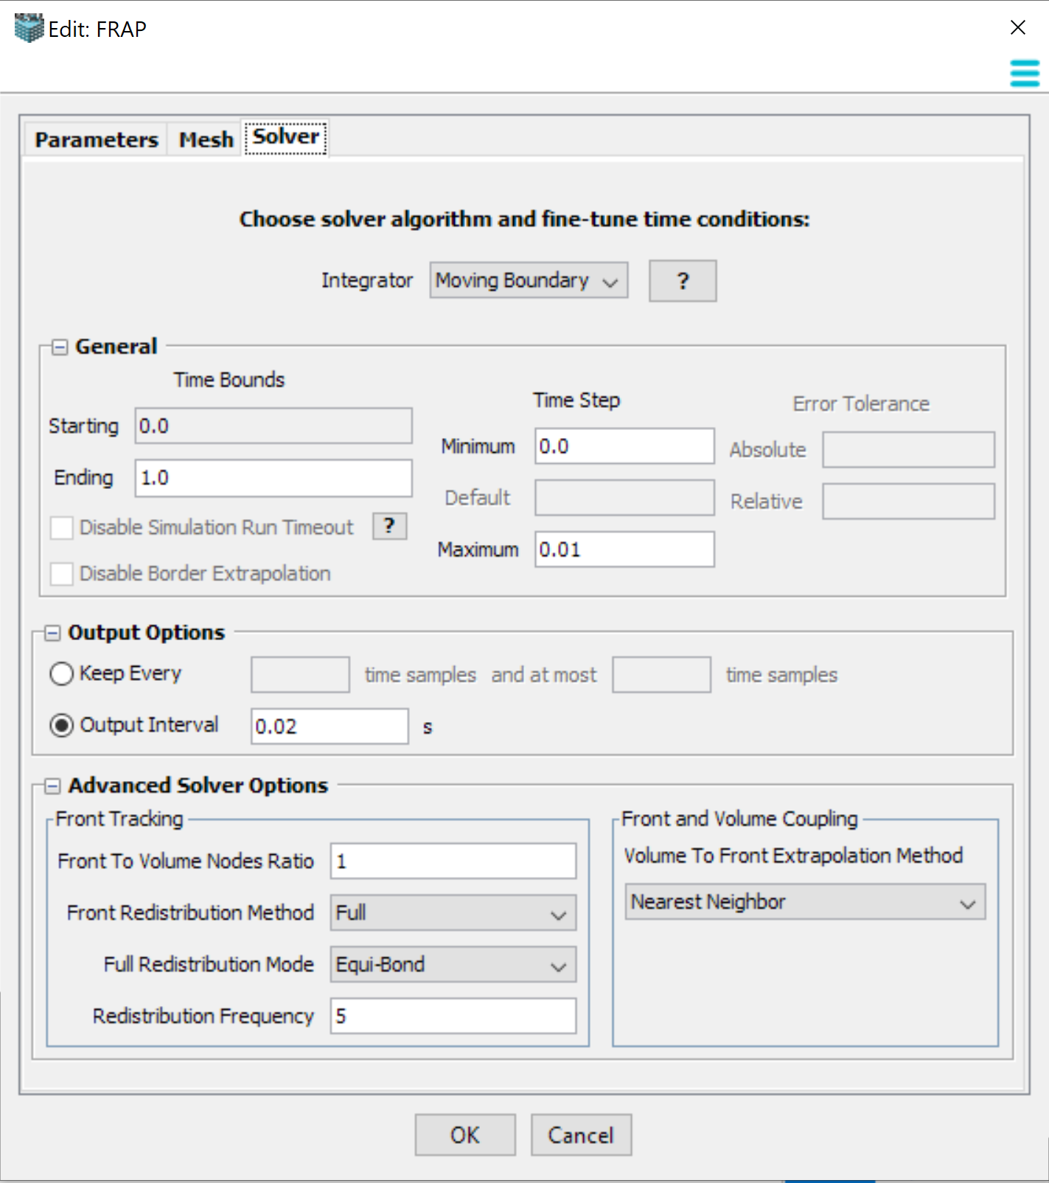
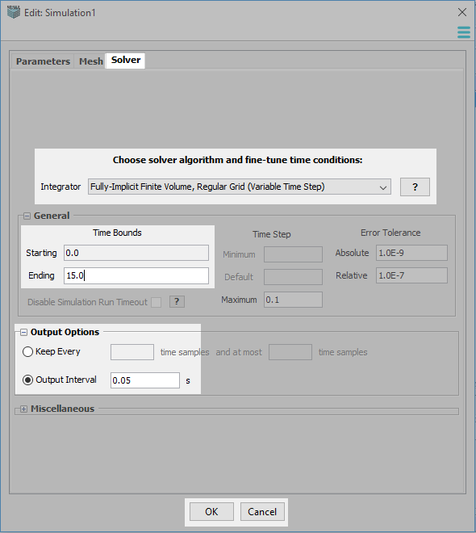
Select the “Solver” tab to configure solver-specific options. Use “OK” to accept text changes.
The Moving Boundary solver is selected by default whenever kinematics are defined
Change the Minimum and Maximum time steps
Change the Output options
Note: The solver computes the appropriate time step at each point; the output option only chooses which points you choose to save. Selecting a particular interval will ensure the solver uses those specific times in the computation.

Slide 7
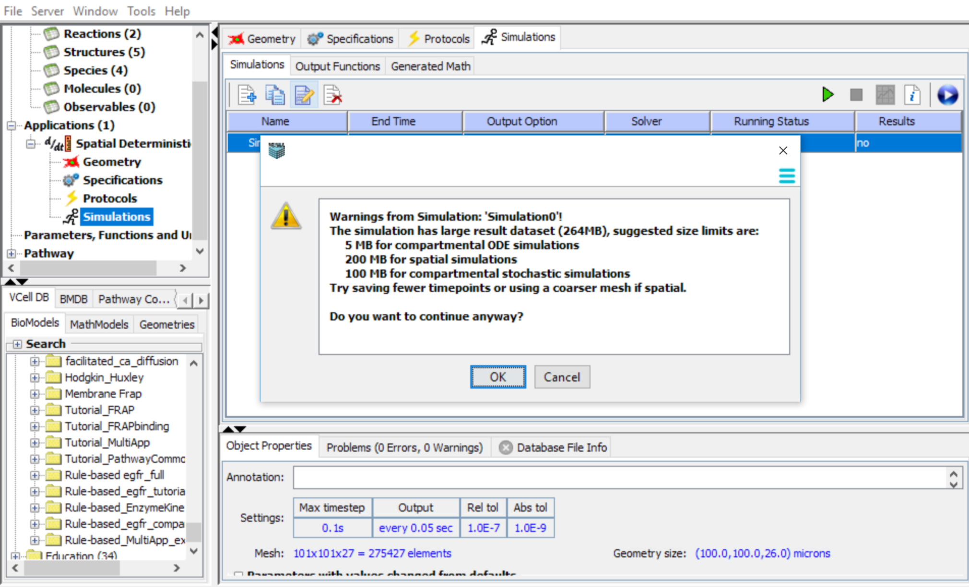
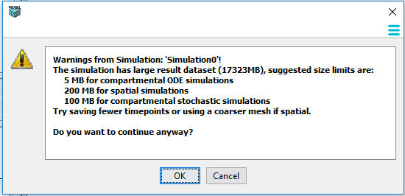
You may receive a warning regarding the size of your simulation. You should select “OK” and run the simulation.

Slide 8
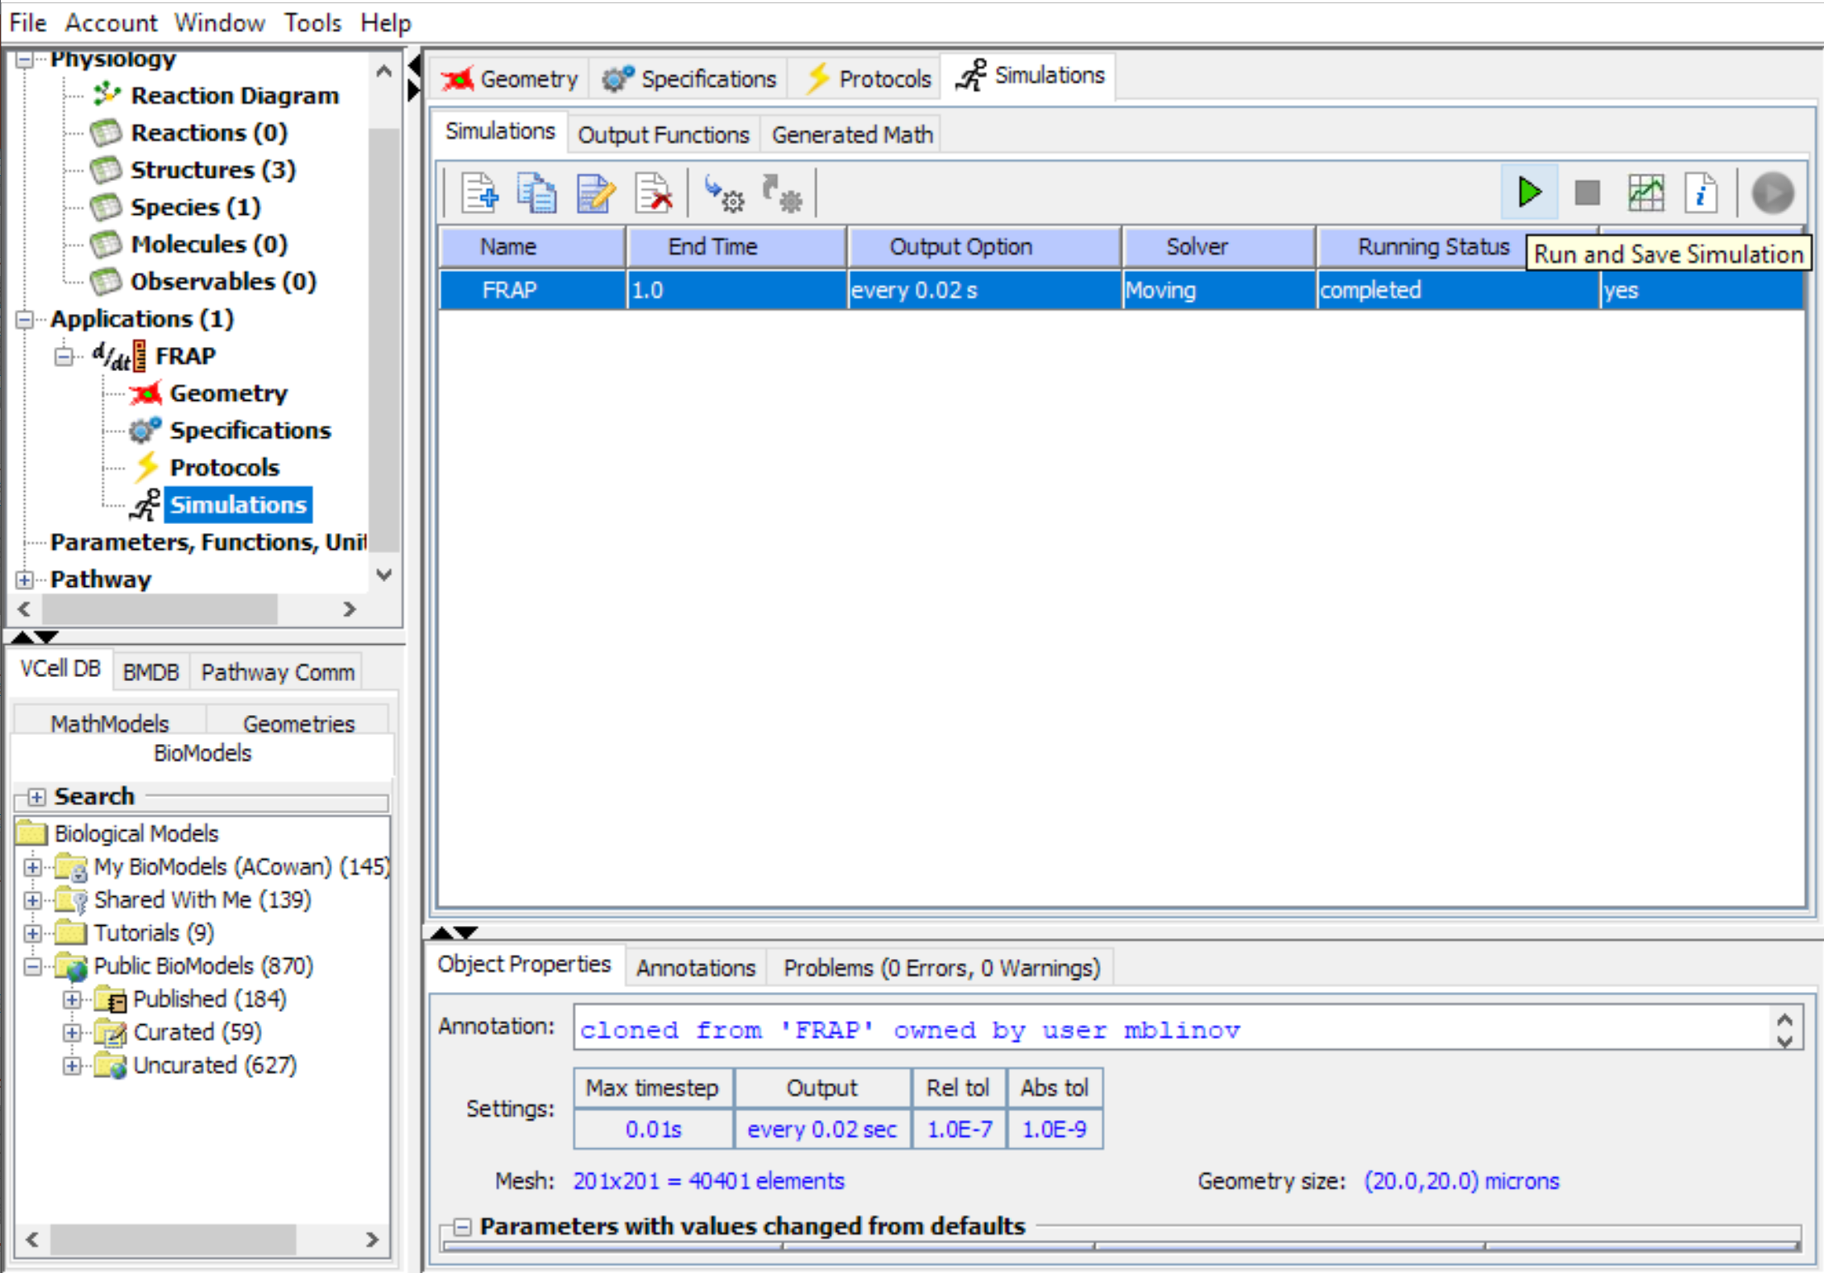
Select the simulation you want to run, then click the green “run” arrow to save the model to the database and run the simulation on the remote servers at VCell. Your simulation results will be saved in the database.

Slide 9
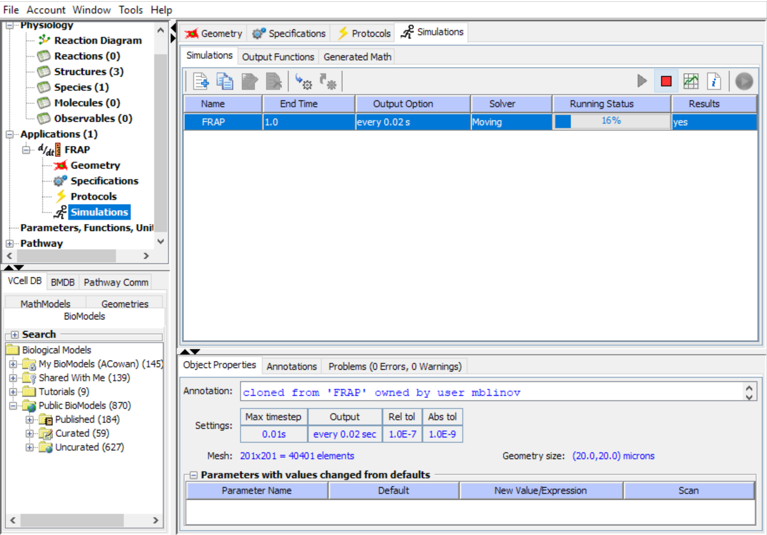
To view the status of the simulation, look under the “Running Status” column.
Use the “View Results button to see the simulation results.
Note: You can view results any time the Results tab says “yes”, even before the simulation is 100% complete.

Slide 10
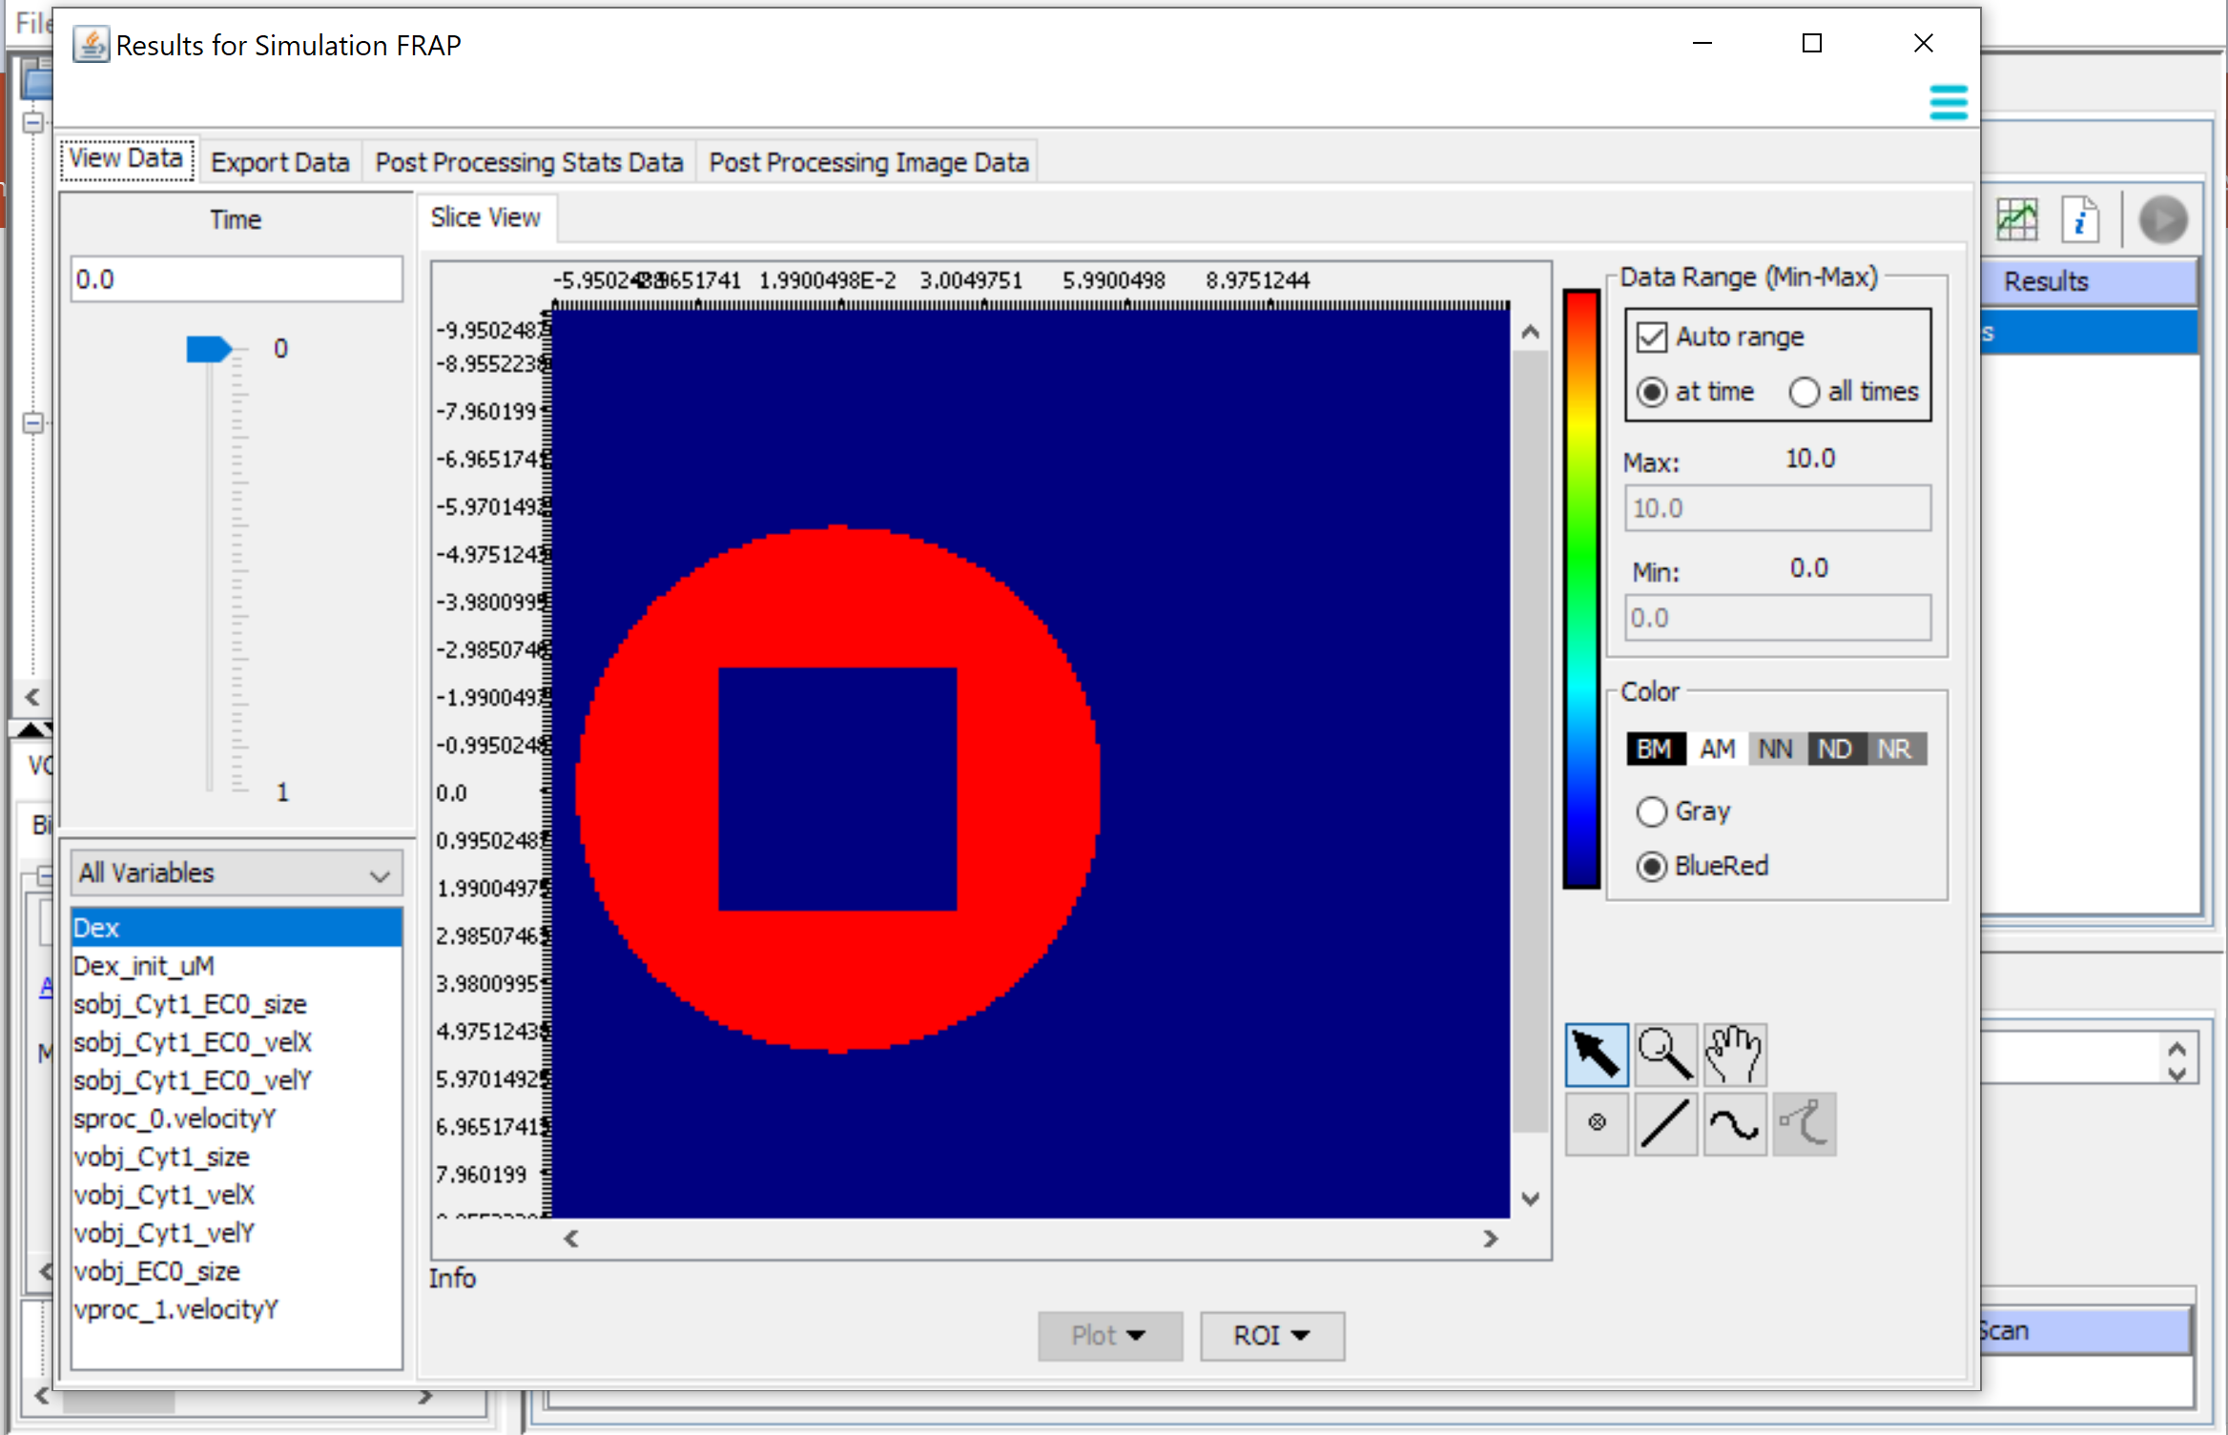
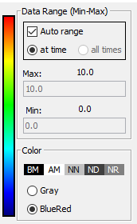
Select the Time Point using the slider.
Select the range for the BlueRed or Gray color map. By default it is automatically set to the Max and Min at that time point
Select the Variable to view
Note: Unclick “ Auto range” and set the values in the Max and Min boxes to enforce a constant range for the entire time course.

Slide 11
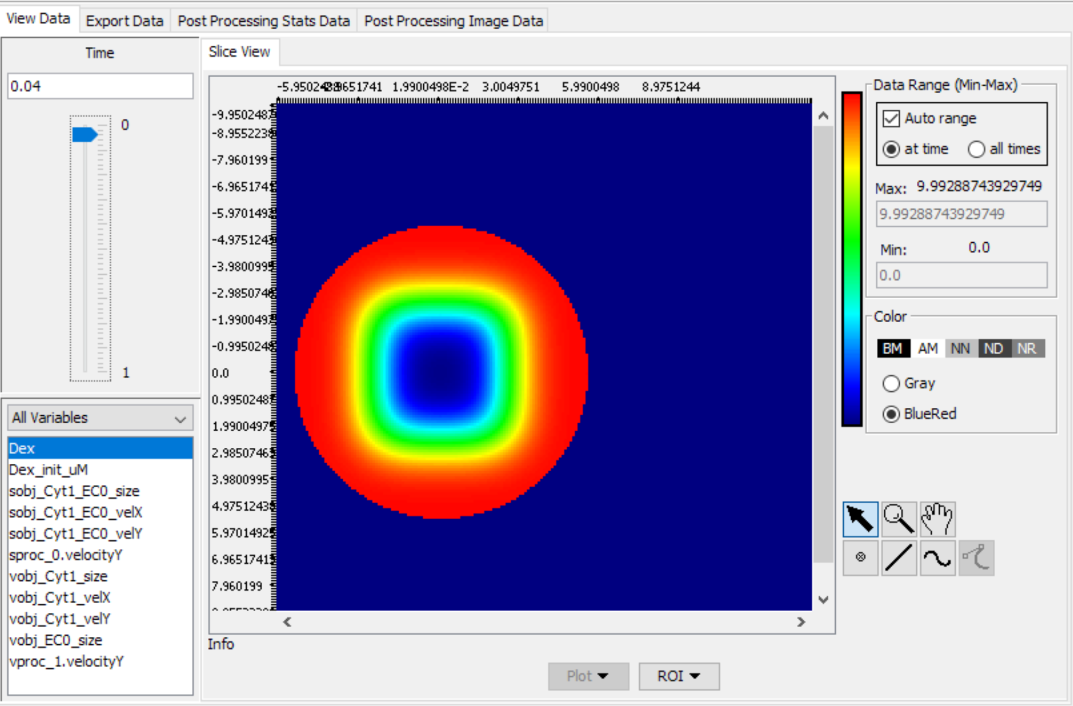
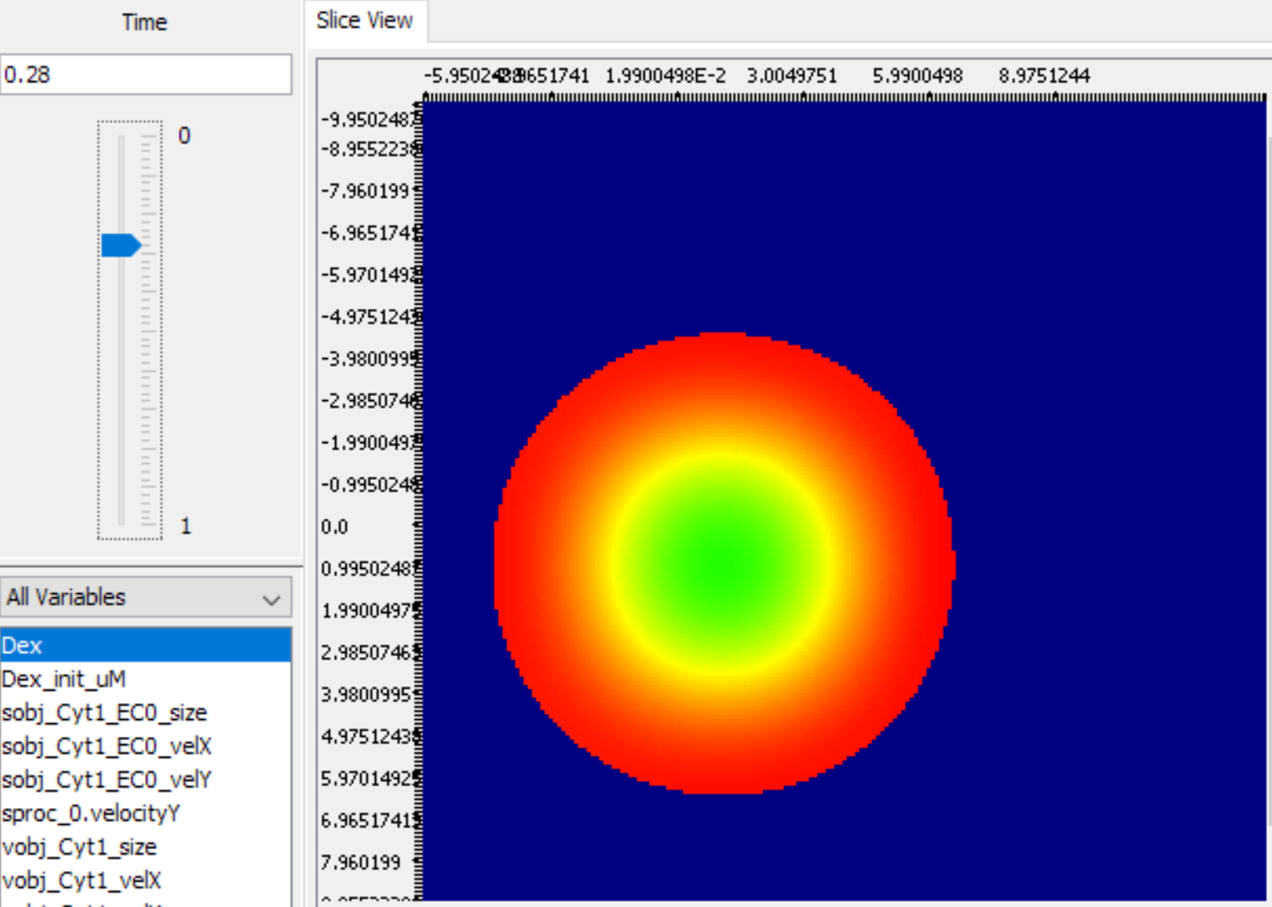
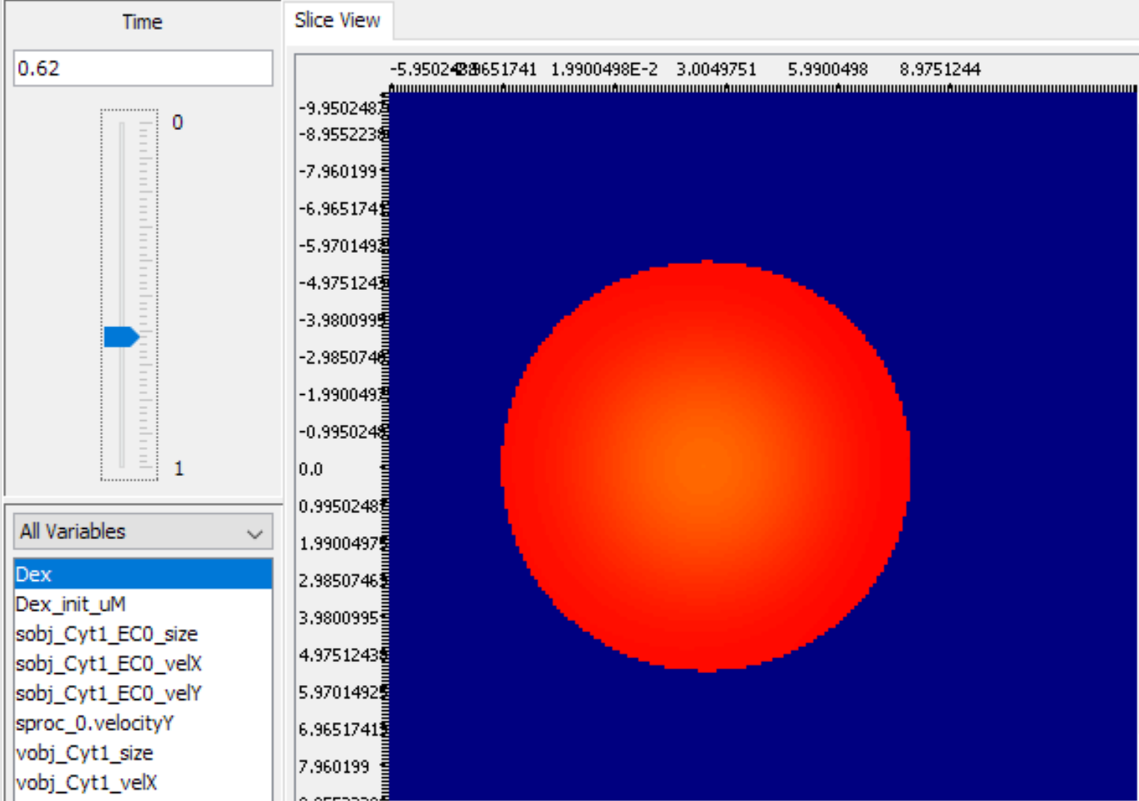
Note: The data Range (Min-Max) had Auto range selected for these images, so the color scale is different at each time point.

Slide 12
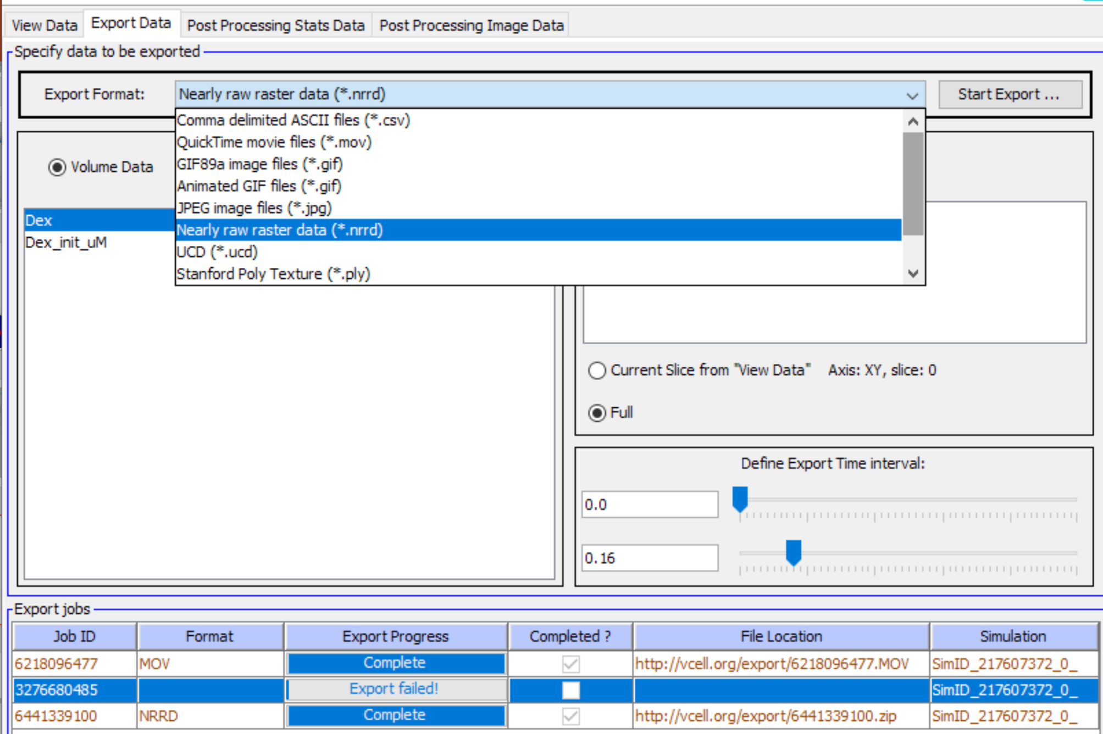
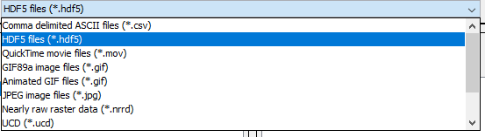
Use the “Export Data” functions to help analyze the results. From the drop down menu of export formats, select either “HDF5 files” or “Nearly Raw Raster Data (nrrd)” to output a time sequence of the concentration data as floating point values.

Slide 13
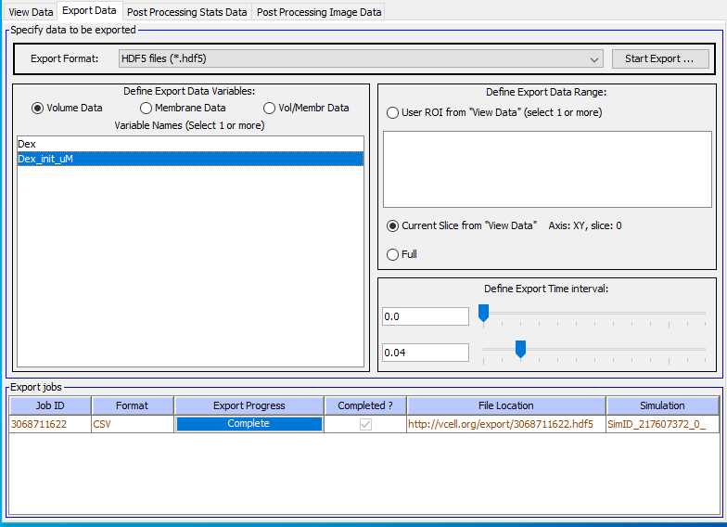
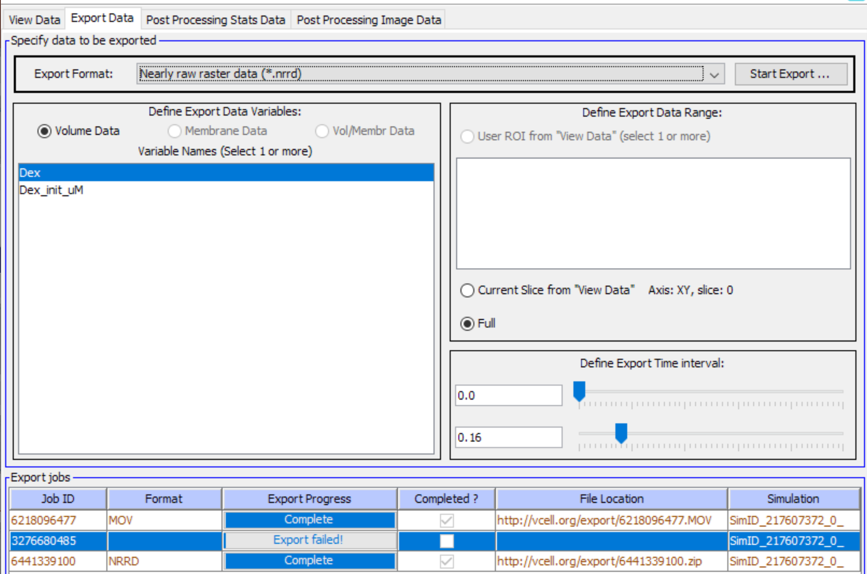
To export as HDF5 files:
Select the Species to export (there is only one in this model).
Select the Time Interval to Export

Slide 14
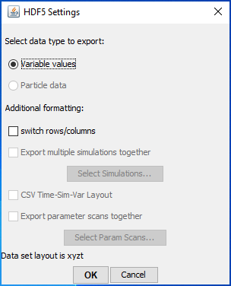
Selecting “Start Export” will bring up a HDF5 settings window. Use the default settings and select “OK”

Slide 15
To export as HDF5 files:
Select the Species to export (there is only one in this model).
Select the Time Interval to Export

Slide 16
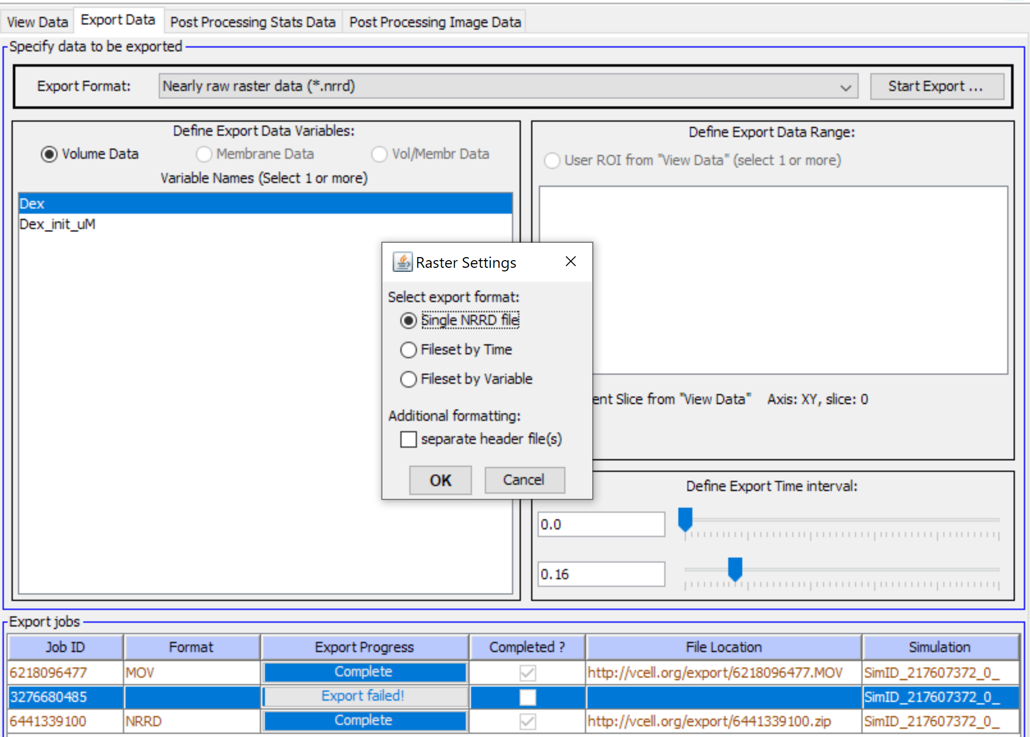
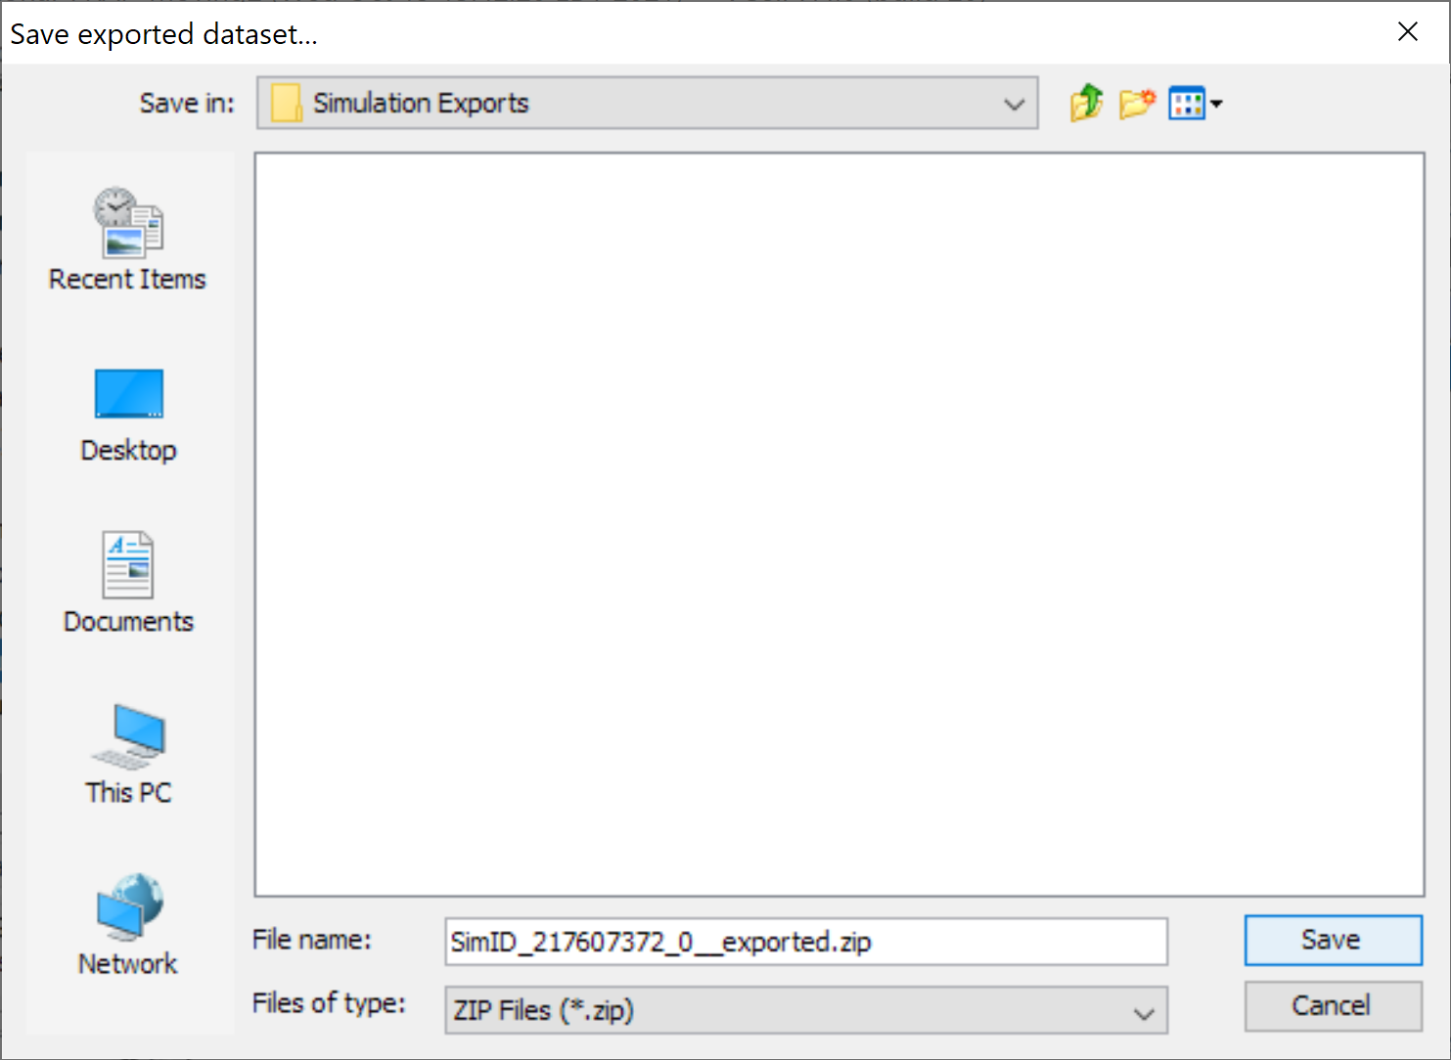
Click “Start Export” and an additional dialog box appears with NRRD specific options. Use the selections shown here, there press “OK”
Export jobs are saved to the server; when the job is complete you are prompted to save a local file.

Slide 17
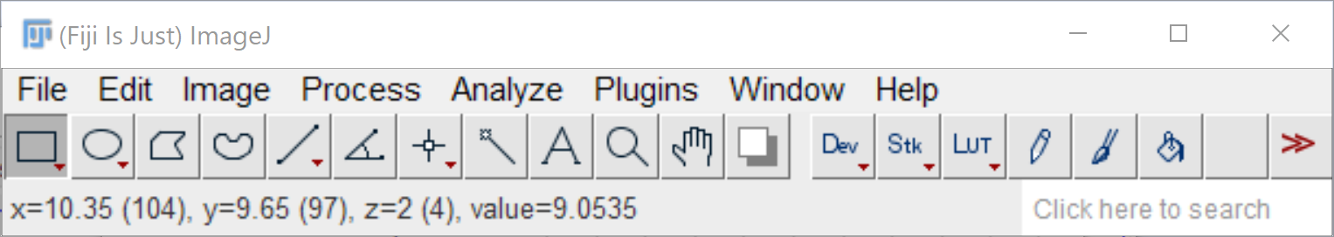
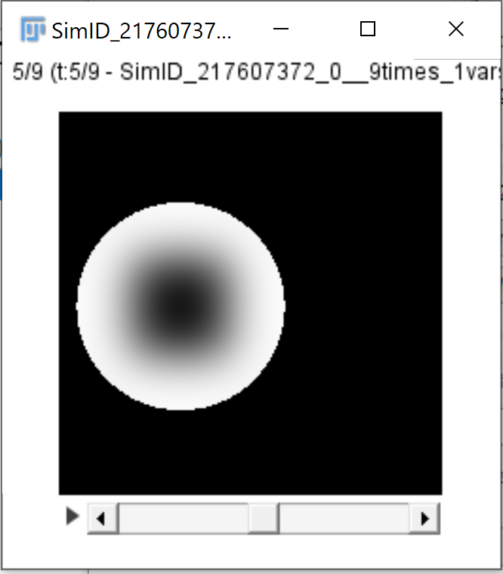
HDF5 and NRRD files can be opened and analyzed in a variety of imaging processing software including FIJI/ImageJ.

Slide 18
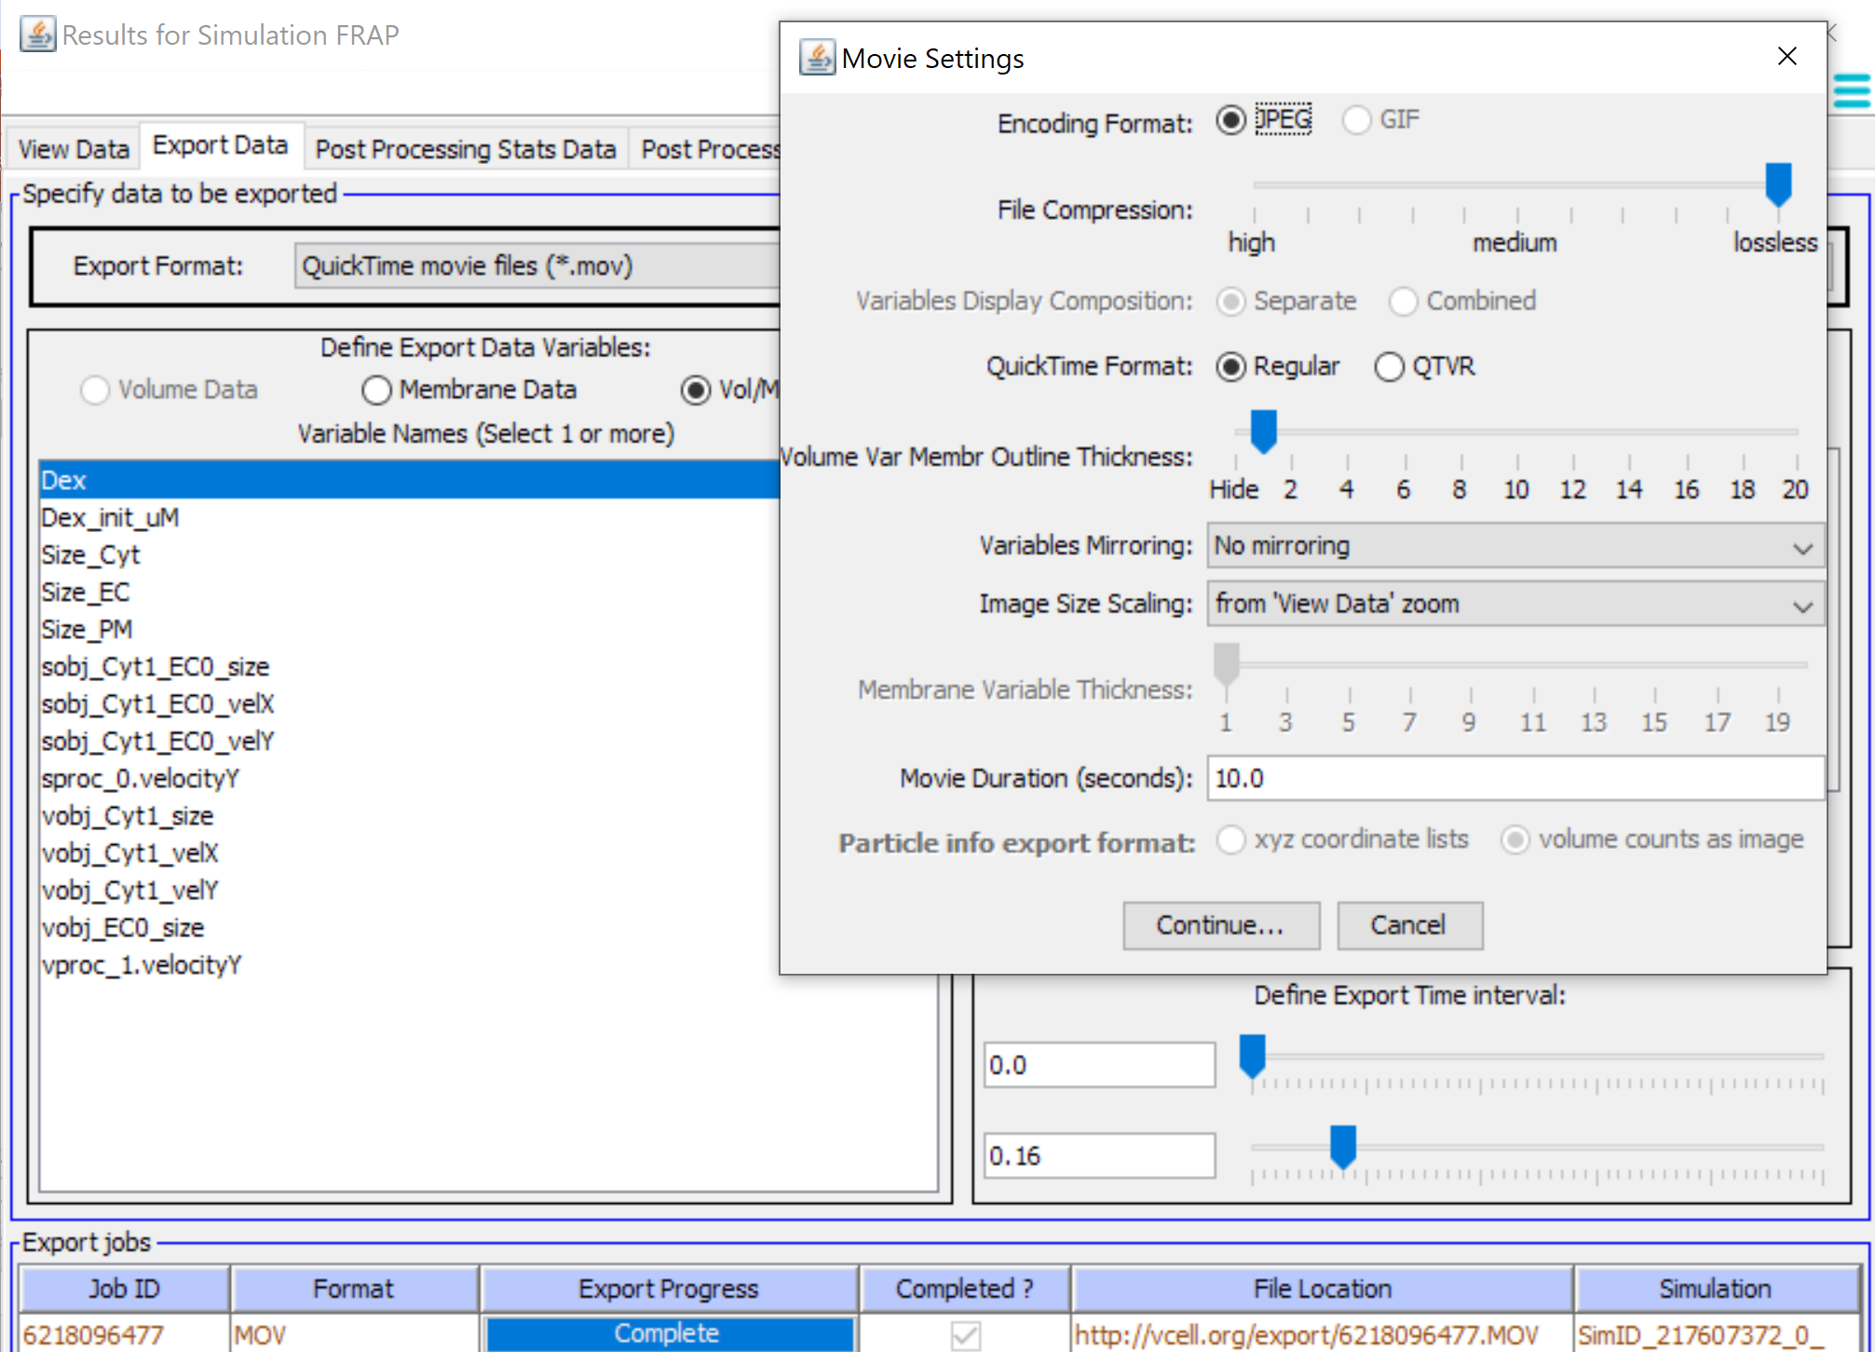
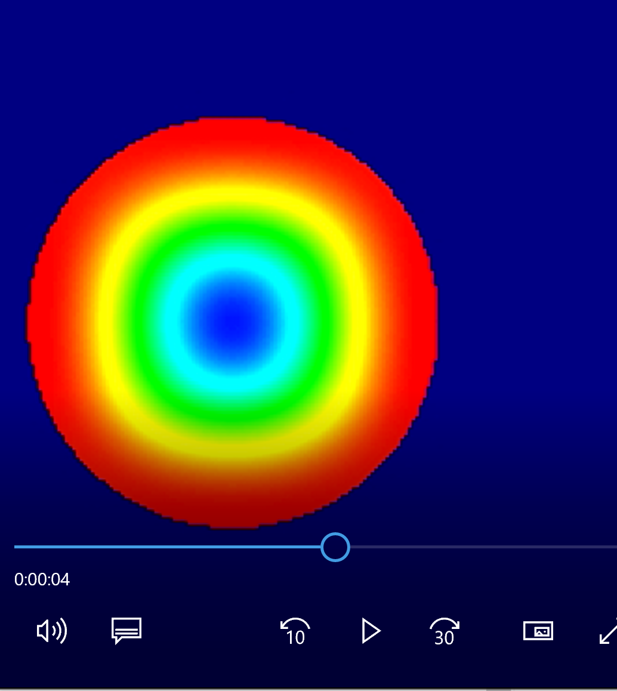
You can also export a Quicktime movie for presentations.

Slide 19
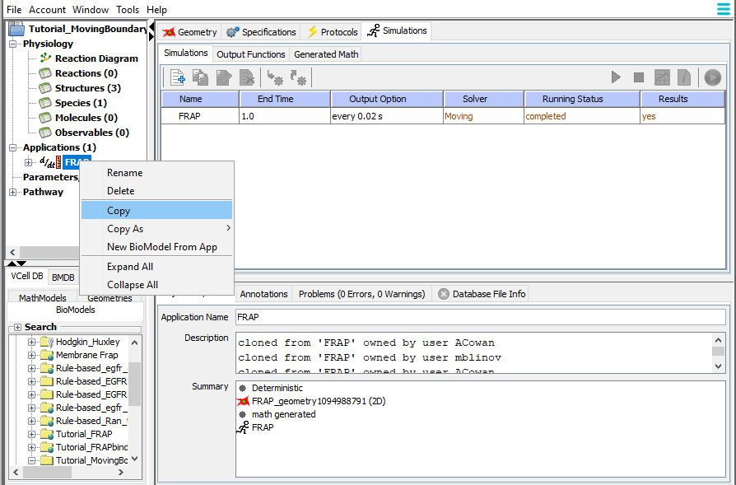
Let's create a second Application to change the parameters for both the kinematics and diffusion coefficient and see how that affects the spatial distribution of the fluorescent probe
Right click on the FRAP application from the navigation window and select “Copy” to copy the original FRAP application.

Slide 20
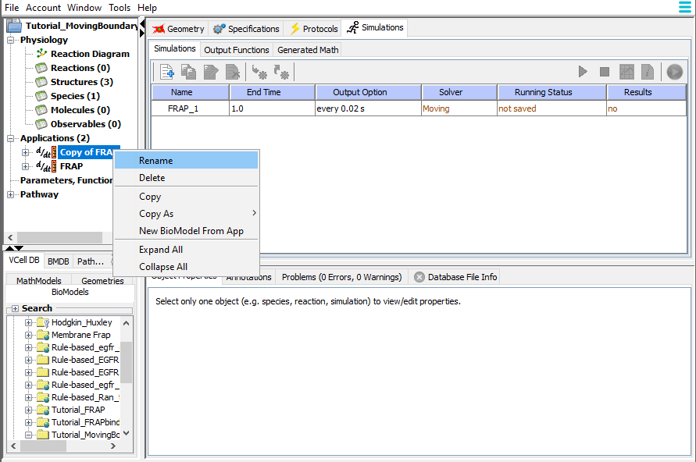
Right click on the Copy of FRAP application and select “Rename” to copy the original FRAP application.

Slide 21
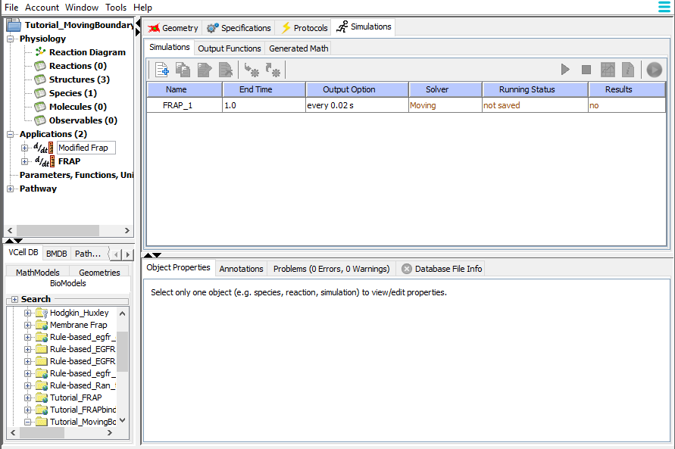
We can call the new Application “Modified FRAP”. You need to use the enter key to accept the new name.

Slide 22
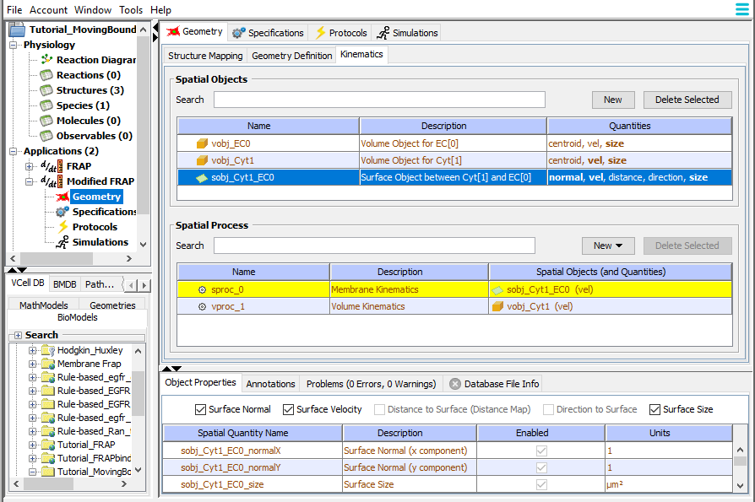
Return to the Geometry > Kinematics tab
Select the surface object sobj_Cyt1_EC0
Select the “Surface Normal” check box to enable a kinematic process to apply to the normal to the surface.

Slide 23
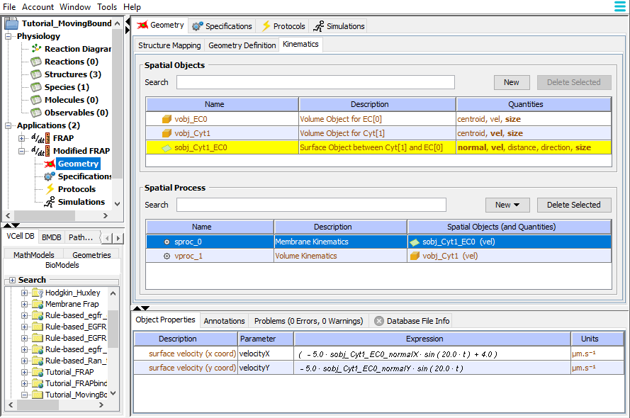
Select the Spatial Process for the surface object sobj_Cyt1_EC0 so the surface velocity properties appear in the bottom window.
Change the expression for the surface velocity for x to (( - 5.0 * sobj_Cyt1_EC0_normalX * sin((20.0 * t))) + 4.0). Change the expression for the surface velocity for y to ( - 5.0 * sobj_Cyt1_EC0_normalY * sin((20.0 * t)))
The expression for the surface velocity will move the normal to the surface in both x and y, thus causing the membrane to contract and expand; overall x will have a constant velocity of 4 µm/s.

Slide 24
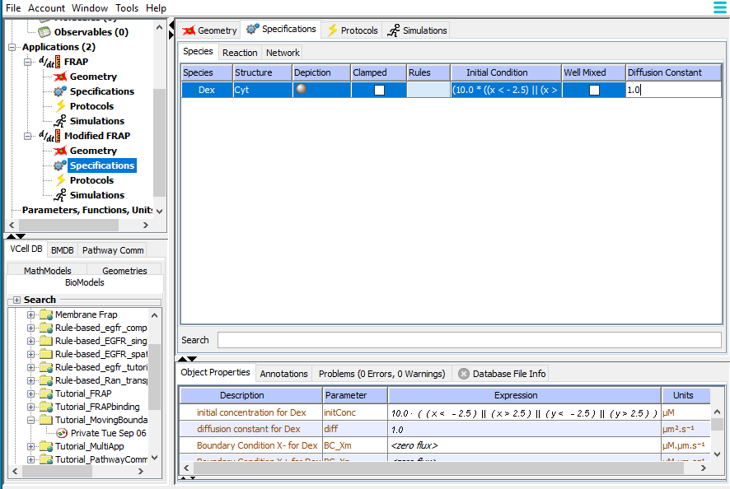
Go to the Specifications tab and change the Diffusion Constant to 1.0. Double click in the box to edit.
For this demonstration, the diffusion constant is for a large, slowly diffusing species. The simulation results will show what happens to a slowly diffusing volume species when the membrane contracts rapidly.

Slide 25
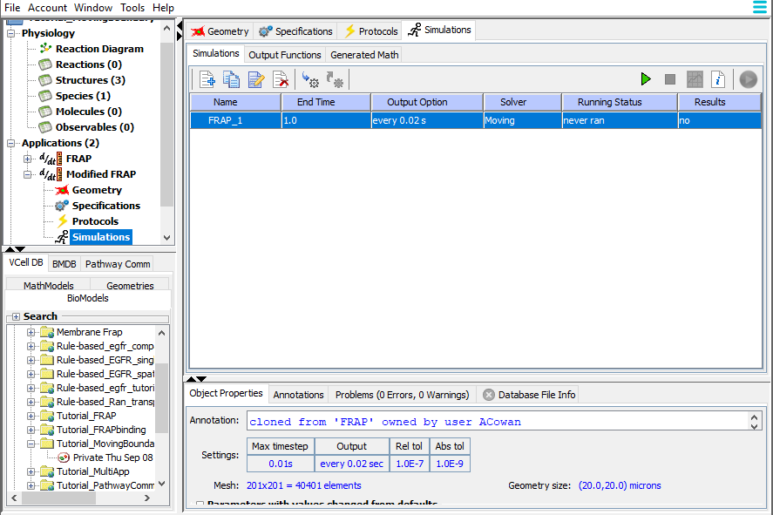
Go to the Simulations tab. The simulation will have been copied along with the application, but not run. There is no need to edit the simulation parameters, and you can simply run by selecting the green arrow to run remotely on VCell servers.

Slide 26
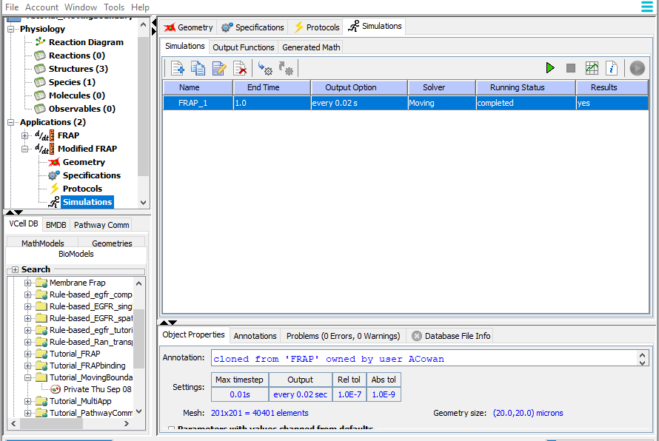
Once Running Status indicates there are results, select the simulation and use the graph icon button to open the results viewer

Slide 27
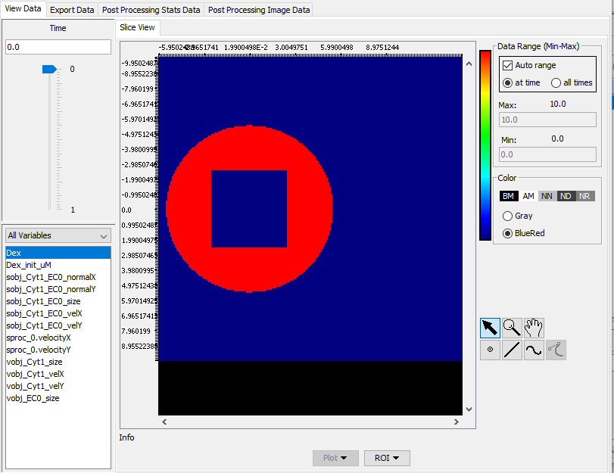
Use the Time slider to see what happens during the simulation.

Slide 28
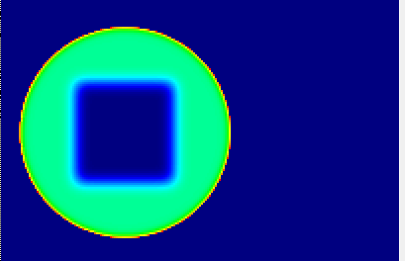
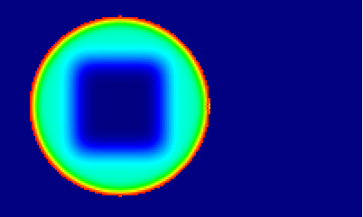
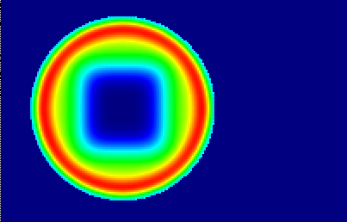
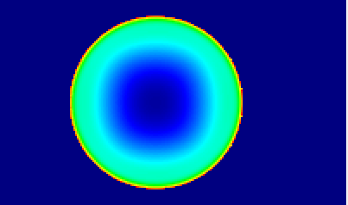
The velocity of the membrane contraction is sufficiently fast that the volume species becomes concentrated under the membrane before the concentration gradient can be dispersed by diffusion. When the membrane expands, there is a low concentration of dex under the membrane as it diffuses into the newly created volume.
t = 0.04 s
t = 0.16 s
Note that autorange is selected for each image.
t = 0.26 s
t = 0.46 s

